Slide 1

Day-08
JQUERY - UI
Notes:
NOTE:
To change the image on this slide, select the picture and delete it. Then click the Pictures icon in the placeholder to insert your own image.

Slide 2
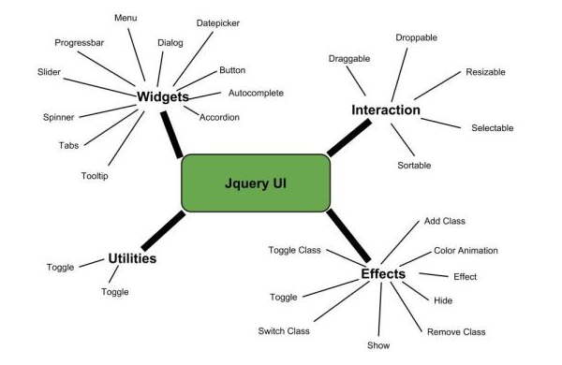
What you will learn today?
Creating a rich user interface using jQuery UI

Slide 3
Interactions:
For Reference: https://jqueryui.com/
Interactions is a set of mouse-based instructions used as building blocks for rich interfaces and complex widgets. These are the mostly used interactions:
Draggable
Droppable
Resizable
Selectable
Sortable

Slide 4
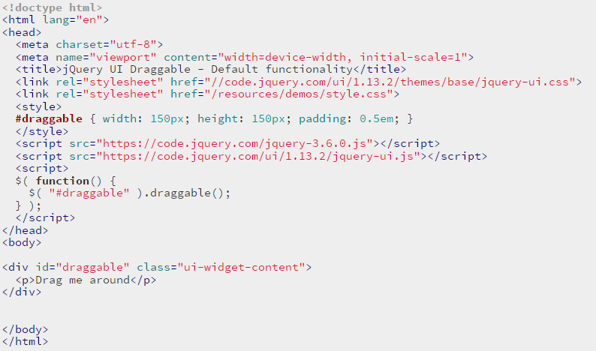
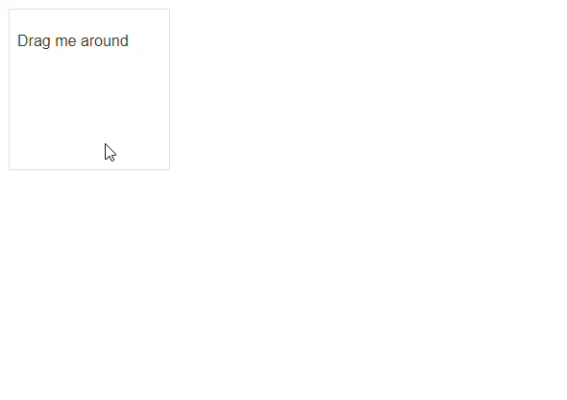
Draggable:

Slide 5
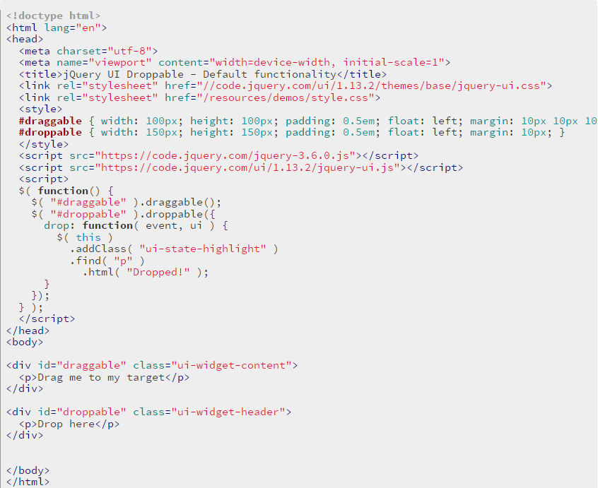
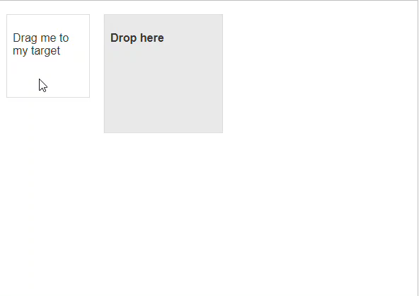
Droppable:

Slide 6
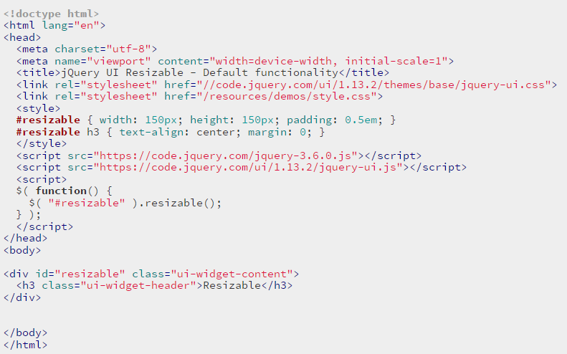
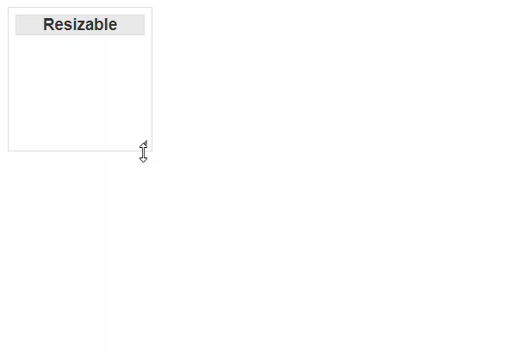
Resizable:

Slide 7
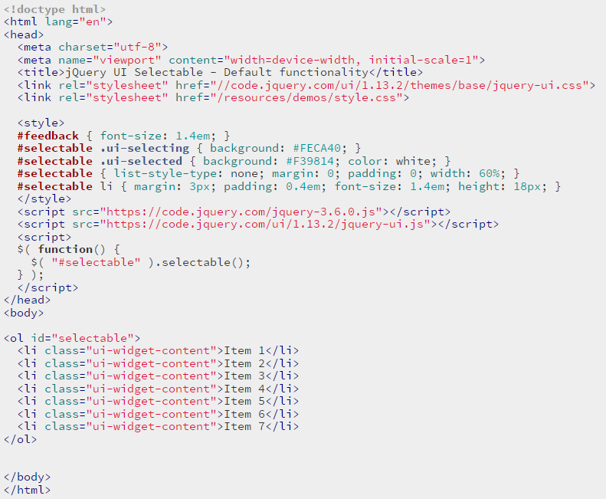
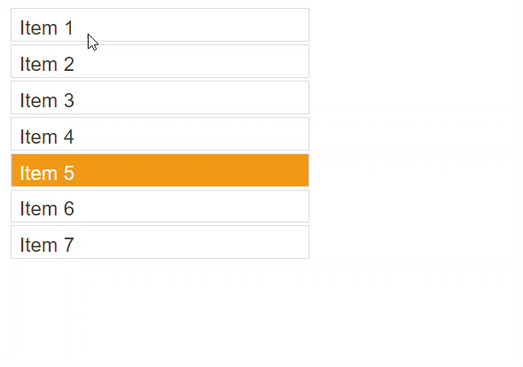
Selectable:

Slide 8
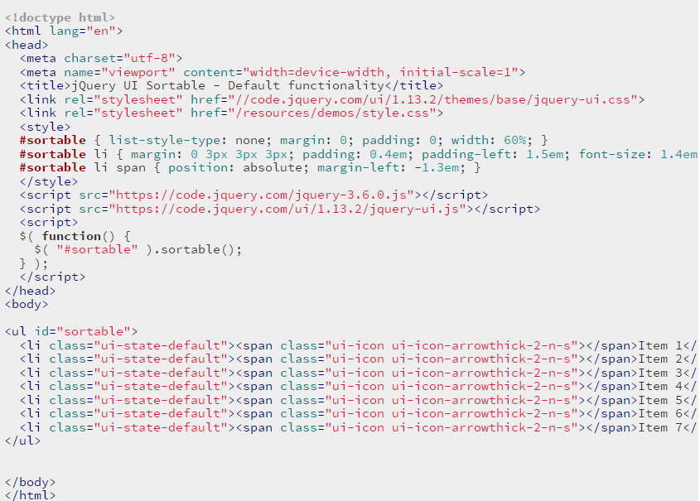
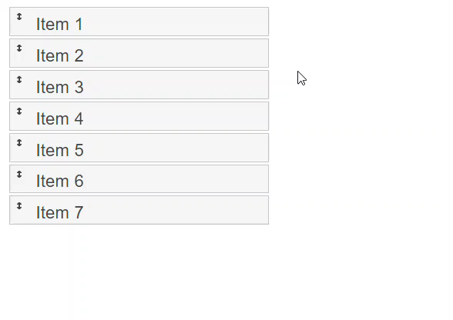
Sortable:

Slide 9
Widgets:
For Reference: https://jqueryui.com/
Widgets are feature-rich, stateful plugins that have a full life-cycle, along with methods and events. These are the most used widgets:
Accordion
Autocomplete
Dialog
Button
Date Picker
Menu
Progress Bar
Tabs
Tooltip
Slider
Spinner

Slide 10
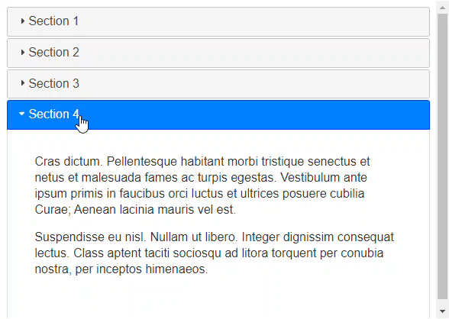
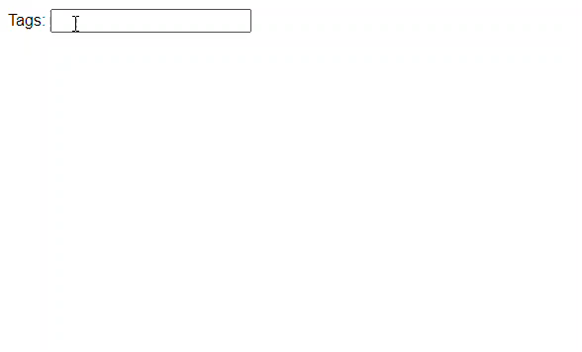
Widgets:
Accordion
Autocomplete

Slide 11
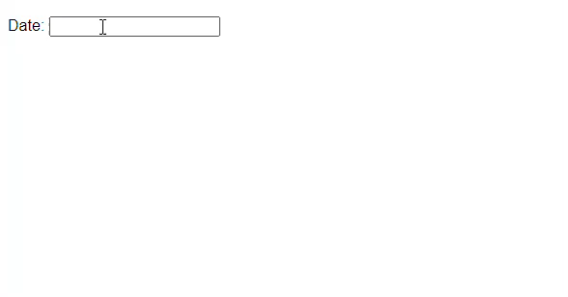
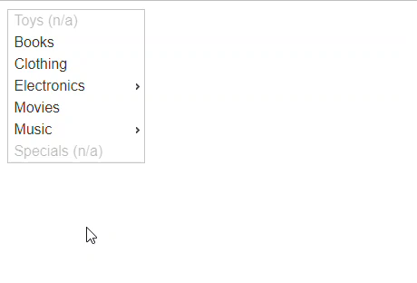
Widgets:
Date Picker
Menu

Slide 12

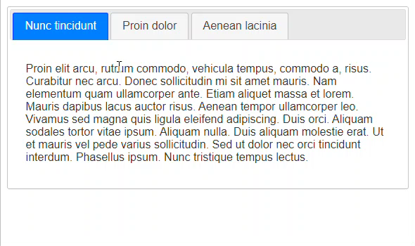
Widgets:
Progress Bar
Tabs

Slide 13
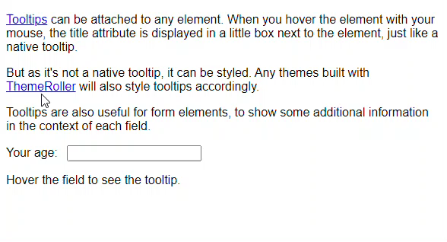
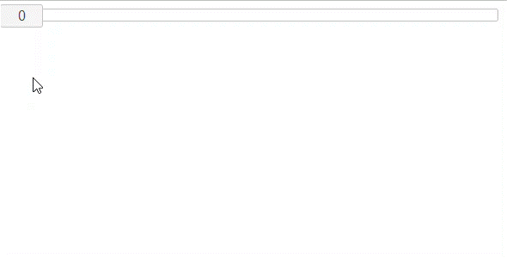
Widgets:
Tooltip
Slider

Slide 14
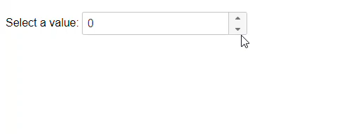
Widgets:
Spinner

